Slide 1
Using Machine Learning to Predict Which of Iowa’s Prisoners Will Return to Crime
James M. Irving, Ph.D.

Slide 2
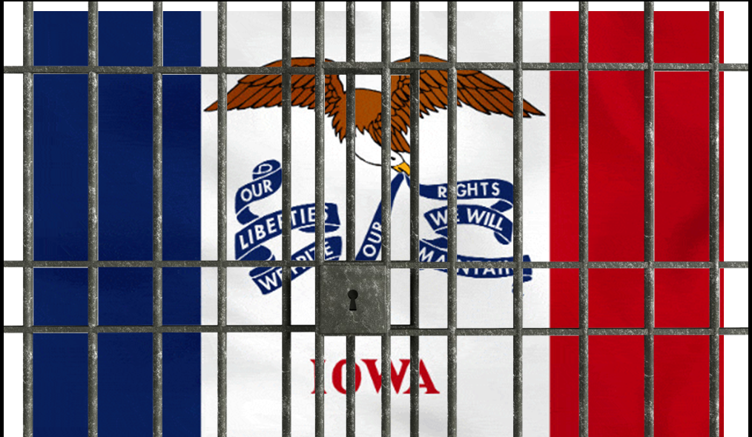
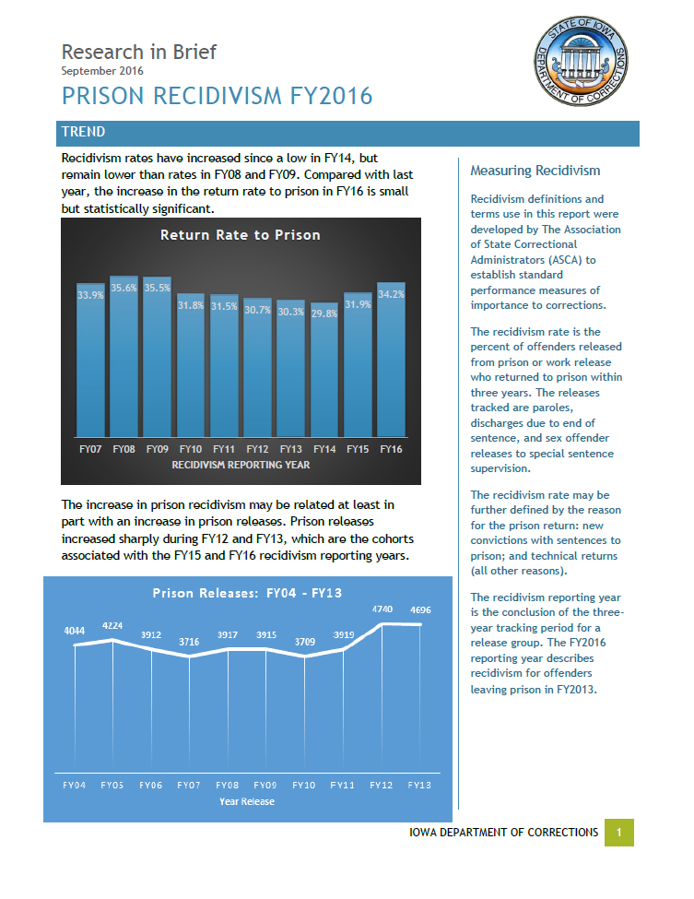
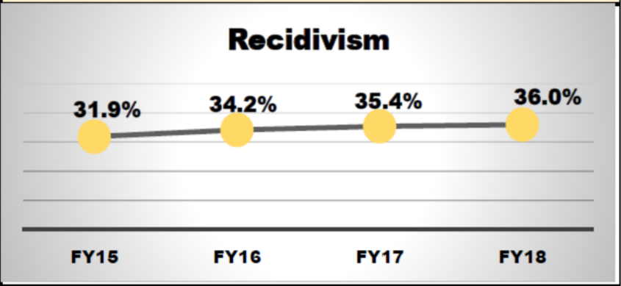
IOWA’S RECIDIVISM PROBLEM
By 2015, nearly 1/3 of all released prisoners from Iowa were returning to crime.
In 2015, US Dept. of Justice gave Iowa $3M Grant to help reduce
However recidivism rates continue to climb (36% 2018).
From: https://doc.iowa.gov/data/prison-recidivism-fy2016
Excerpt form IOWA Dept of Corrections Annual Report - 2018

Slide 3
Can we use data describing Iowa’s released prisoners to predict which prisoners will return to a life of crime?
FUNDAMENTAL QUESTION

Slide 4
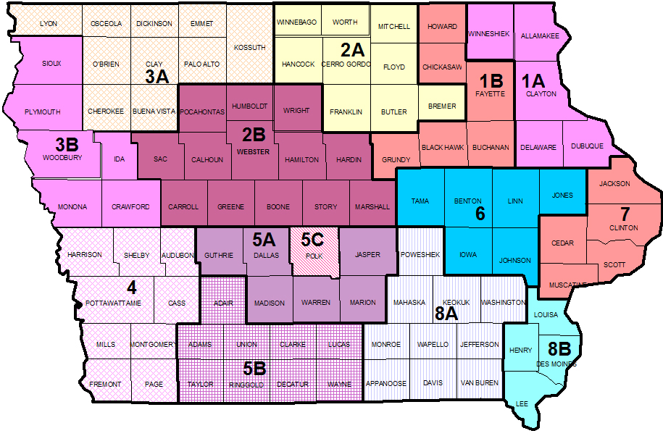
Data Source: Iowa Dept. of Corrections
Features Analyzed:
Convicting Offense Classification
Convicting Offense Type
Convicting Offense Subtype
Release Type
Main Supervising Judicial District
Race - Ethnicity
Part of Target Population
Fiscal Year Released
Recidivism Reporting Year

Slide 5
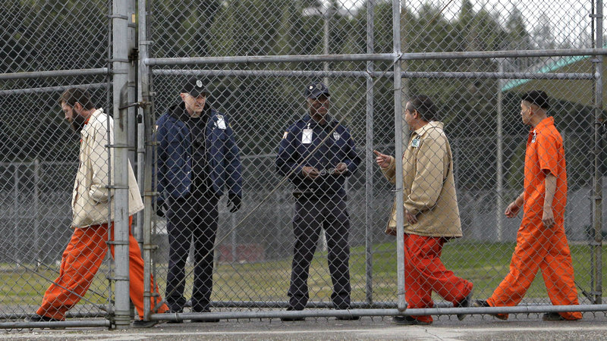
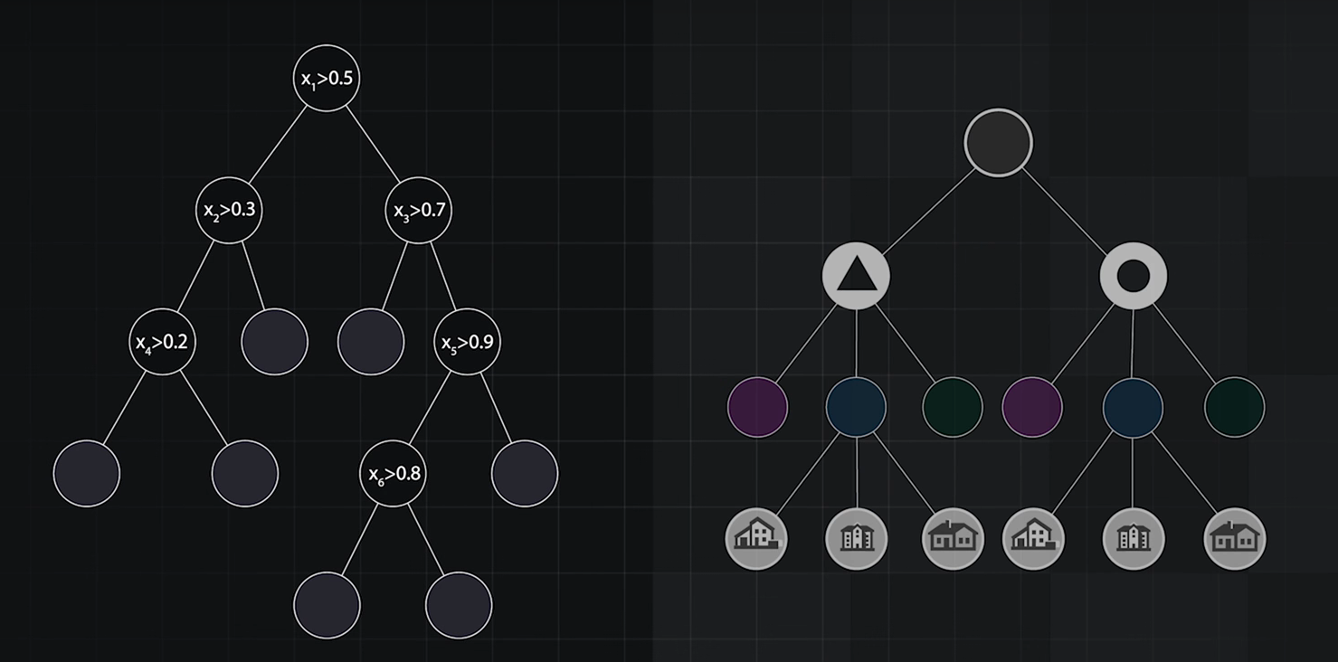
OUR MODEL FOR PREDICTING IOWA’S PRISONER- RECIDIVISM
Used Next-Generation Algorithms
Tree-based classification to find critical points in prisoner data.
Our Model Performance:
70% Accuracy
72% Precision
0.79 AUC (random chance=0.50)
RECIDIVIST
NON-RECIDIVIST

Slide 6
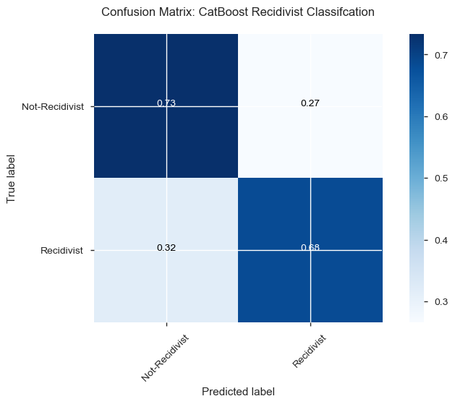
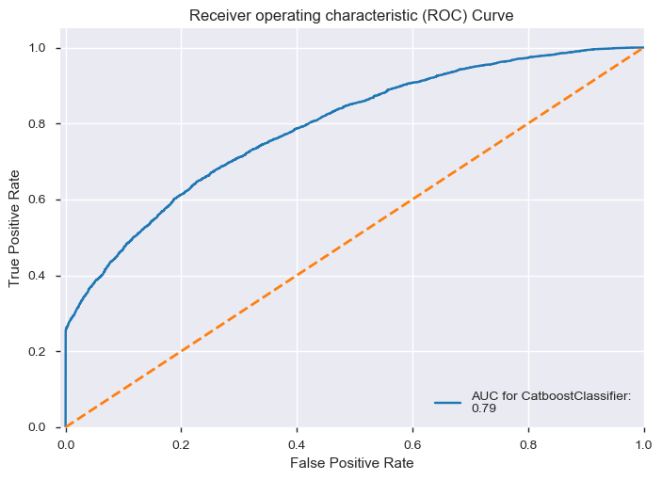
Classification Model Performance

Slide 7
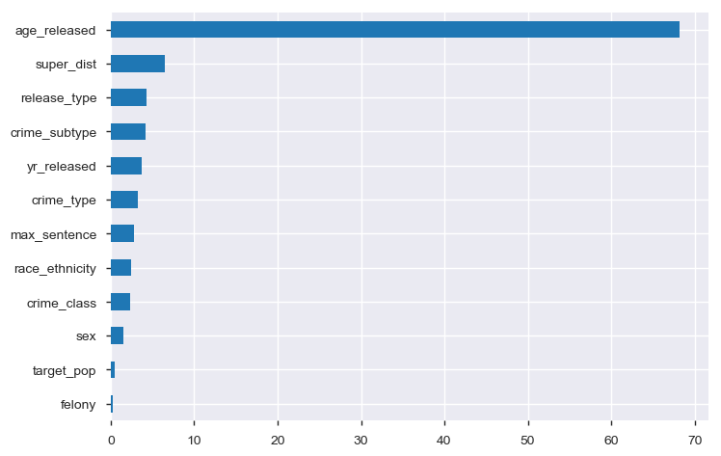
Important Features in Predicting Recidivism
Age-At-Release
Supervising Judicial District
Type of Release
Crime Subtypes
Feature Name
Feature Importance

Slide 8
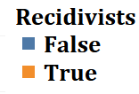
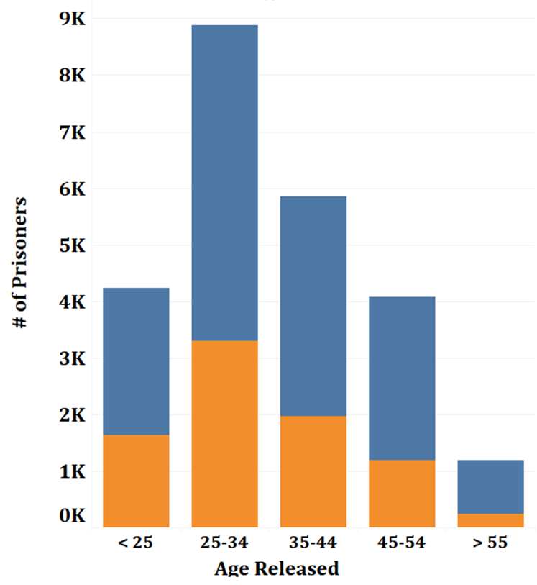
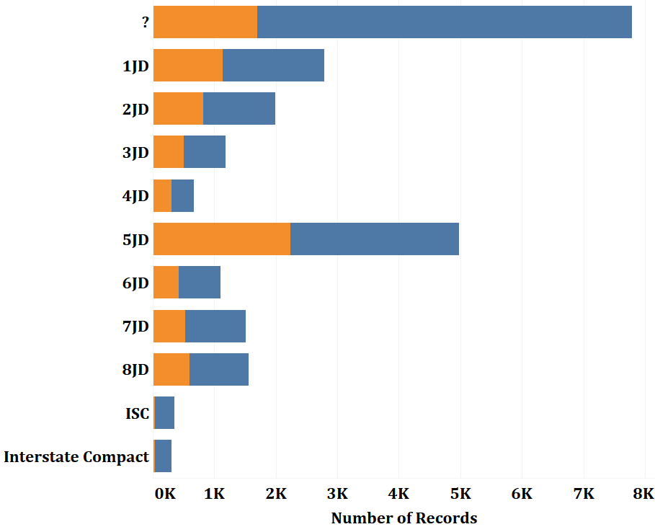
#1) Age at Release #2) Judicial District

Slide 9
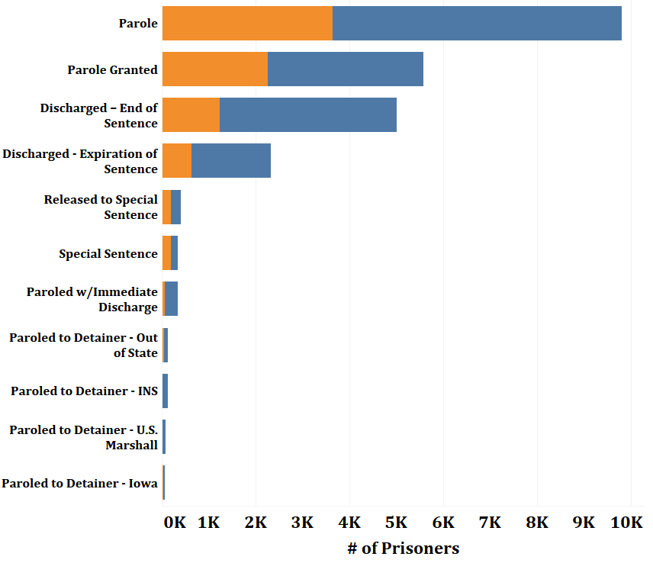
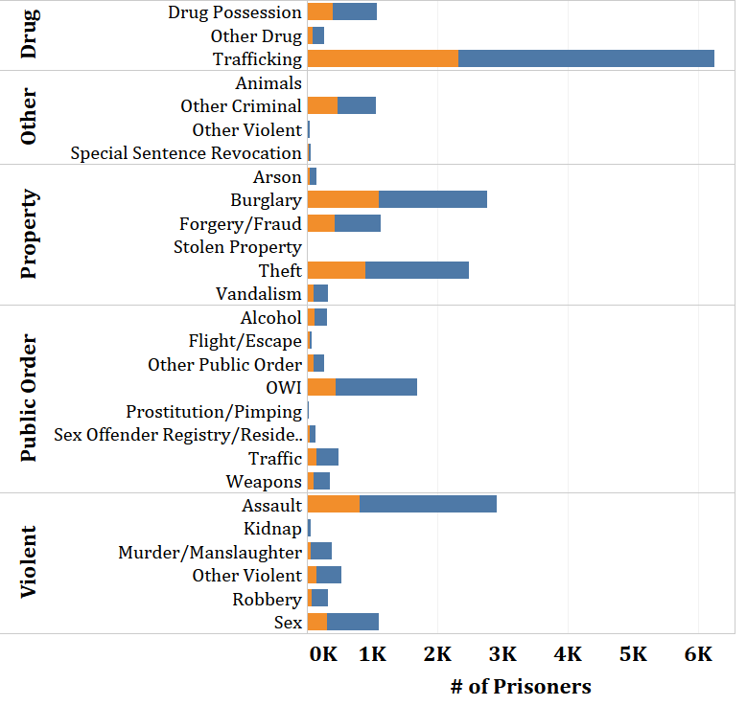
#3) Release Type #4) Crime Type-Subtypes

Slide 10

Conclusions & Recommendations
Using our model, Iowa Department of corrections can predict which prisoners may become recidivist.
Using this information, Iowa can implement pre-release educational programs to target at-risk prisoners.
Following release, Iowa could also provide post-release support and intervention to at-risk prisoners.

Slide 11

THANK YOU
Michael Moravetz – Collaborator
Flatiron School – Data Science Bootcamp
Brandon Lewis – Instructor
Jeff Herman – Advisor
CatBoost Machine Learning Package
Superior Modeling with categorical data.

